Slide 1

Making the Leap from Planning to Implementation in Organizational Transformation
MOHR Annual Conference
May 2024
You go first.
Don Lavin & Staci Jones

Slide 2
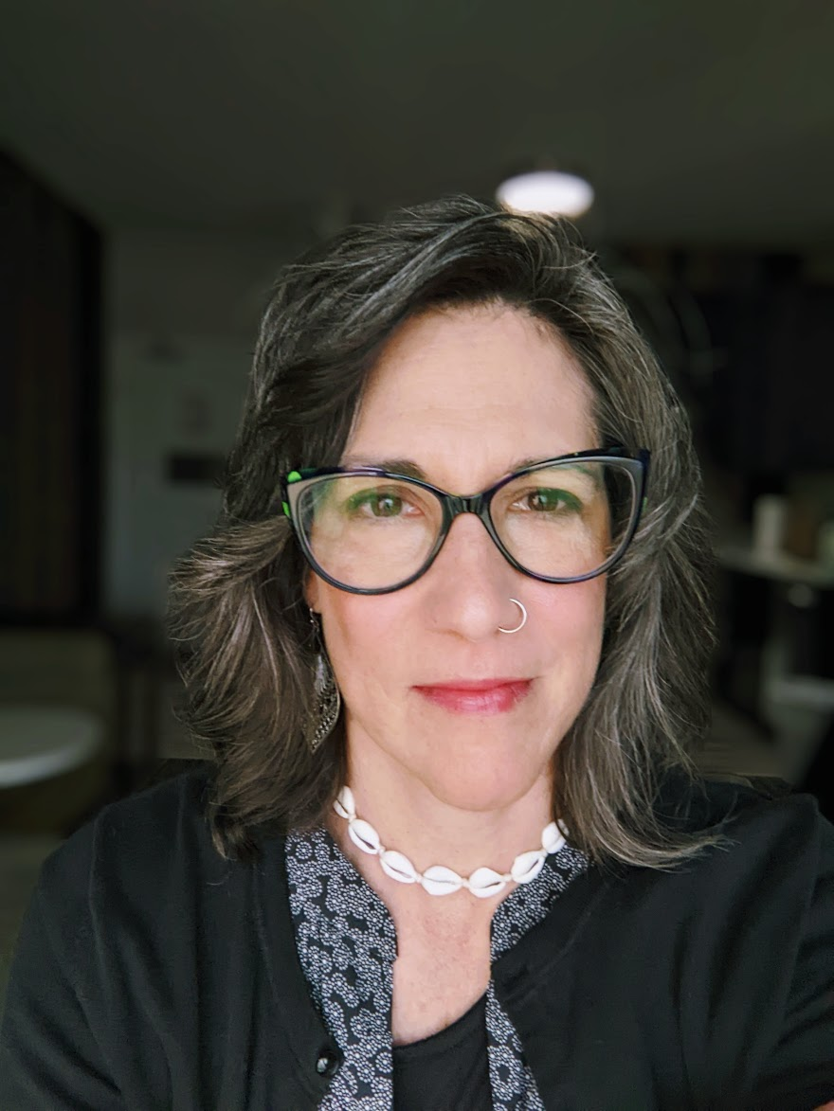
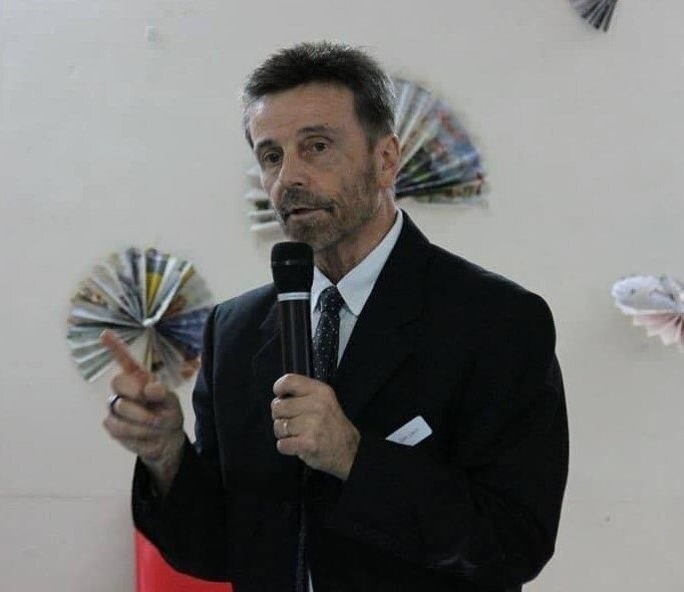

Welcome & Introductions
Staci Jones
Senior Technical Assistance and Policy Associate
ICI Umass, Boston
Staci.Jones@umb.edu
Don Lavin
Principal,
Strengths at Work, LLC
Strengthsatwork@gmail.com
Notes:
Don start, pass to Staci
Brief welcome and introductions

Slide 3
Who's with us today?
What service(s)?
Non-work (Day)
Pre-voc
Employment
Other?
Role?
Direct Support Professional
Designated Coordinator
Middle Manager
Director
Senior Leader
Other?
Notes:
Don
Show of hands for what service(s) are represented (raise your hand for all that apply)
Show of hands for what role(s) are represented

Slide 4

Today's Objectives
Brief "about MTI"
About organizational transformation
The gap(s) between planning and implementation
Breaking through inertia
Use of pilots to scale up
Group exercise
Opportunities for support and resources
Q&A and Survey
Notes:
Staci

Slide 5





MN Transformation Initiative | MN Transformation Initiative (umn.edu)
Notes:
Don
What is the Minnesota Transformation Initiative (MTI)?
5

Slide 6
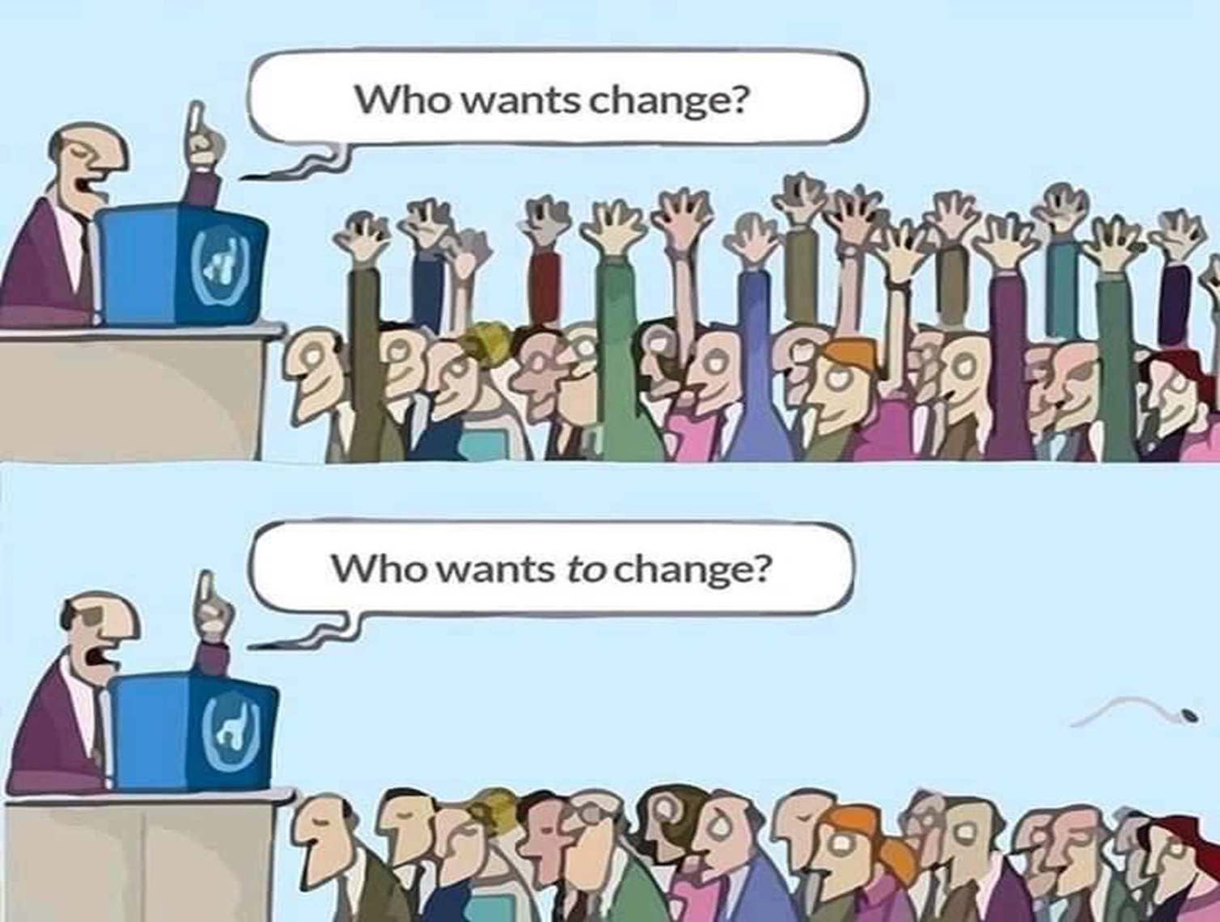
Notes:
Don

Slide 7
About Transformation & Innovation
What, why, how...

Slide 8
Organizational Transformation
Process of strategically aligning mission, vision, practices, processes and outcomes with changing practices & external environment
Notes:
Staci

Slide 9
Organizational Transformation
Why transformation?
State policy and legislation
Best Practices
Federal policy and legislation
Values
History
Process of strategically aligning mission, vision, processes and outcomes.
Notes:
Staci

Slide 10
What are we transforming to?
Historic or Legacy Models | Best Practices, Emerging Practices & Innovative Practices
Center-based, congregate | Integrated, community-based
Subminimum wage, sheltered and/or group employment | Competitive integrated employment
Group day programming | Holistic, individualized, community life engagement
Attendance based | Outcome based
Provider-centric programs | Person-centered services
These require updated business models!
Notes:
Don

Slide 11

Polls
Is your organization engaged in active transformation now? Y/N
2. How far along are you:
  Early
  Middle
  Late
  Not sure....
Notes:
Don

Slide 12


10 Essential Elements of Provider Transformation
www.thinkwork.org
Leadership, Focus & Values
Clear and consistent goals
Agency culture supports inclusion
Employment & Community Life Engagement Practices
Customer focus & engagement
A holistic approach
Active person-centered job development
Infrastructure, Operations & Finance
Reallocated, restructured resources
Strong communication plan
Ongoing staff development
Performance measurement & QA
Diverse community partnerships
Notes:
Staci

Slide 13

Notes:
Don: 3 minutes

Slide 14
The Gap Between
Planning & Implementation

Slide 15

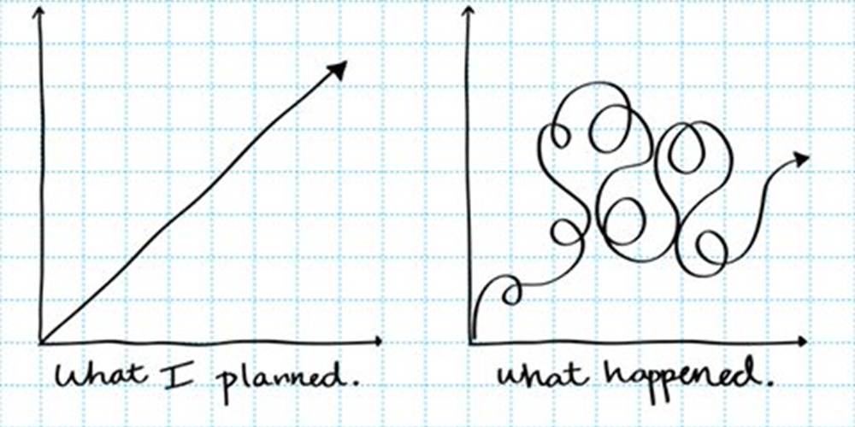

Notes:
Staci
But, as nice and neat as that previous visual is, it doesn't necessarily capture the reality you all may be experiencing which is that transformation can ultimately be pretty messy. You may know where you want to go and maybe even how you want to get there, but it doesn't always look like a nice straight line. It often looks more like the visual of the right. And we believe it's critical to acknowledge this fact. You all are dealing with many different internal and external forces like staffing turnover, accessing training and technical assistance for you and your staff, you are dealing with changes in the labor market and many of you are ultimately creating a brand new service delivery model....at the same time that you are providing services day in and day out. That is not a simple task...and we also know may not have accomplished all that you want to accomplish related to your transformation efforts. You may be close to meeting your goals related to phase out of subminimum wage, but likely you're still working on other transformation goals and objectives because transformation takes time and we want to be thinking about what comes next for your transformation efforts as we near the end of this formalized project. You all have created new systems, new communication flows, new organizational structures, new expectations and there is fantastic momentum that comes with all of those things. We'd like to encourage you to not see this as the end, but instead to be thinking about how you will keeping the momentum of your transformation alive. I'm going to pass things to Brian to outline some ways to keep this momentum moving.,

Slide 16

Flying the Plane While Building it
This Photo by Unknown author is licensed under CC BY-SA.
Notes:
Staci One foot in the old one foot in the new

Slide 17
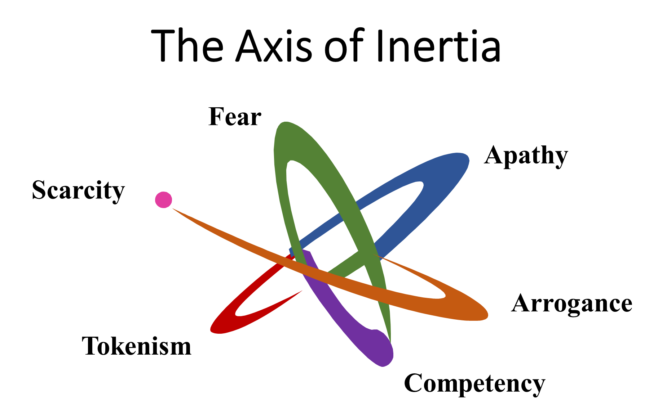
Notes:
Don

Slide 18

Ready, Fire…… Aim!
Notes:
Don

Slide 19
Taking Actionable Steps

Slide 20
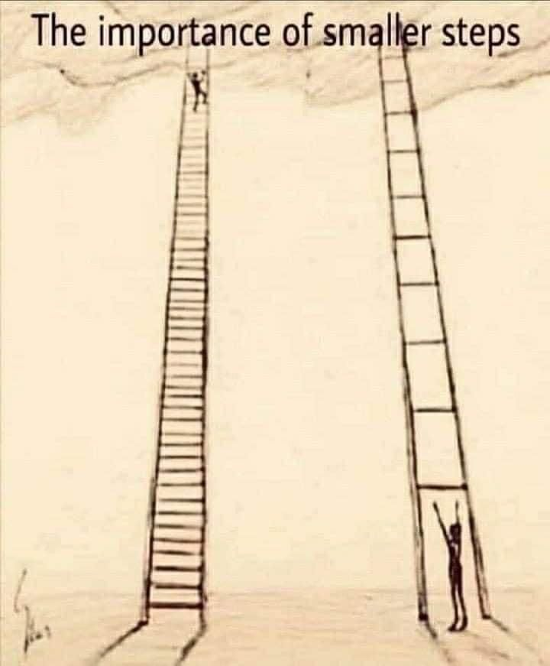
Take smaller, manageable steps
Launch & Benefits of Pilot Projects
Building confidence & learning in practices
Building confidence in securing & rebalancing of revenues
Evaluating metrics & outcomes
Transferring learning to wider organizational practices
Setting attainable & measurable goals
Notes:
Don

Slide 21
Using Pilots
to Plan and Move

Slide 22

The Power of the Pilot
What is it?
Small-scale,
time limited,
controlled trial
Your test phase!
Notes:
Staci
Let's first define what we mean when we talk about using pilots. Essentially, in this context, a pilot is a small-scale, time-limited, controlled trial period of whatever new business process or model you are implementing...it's essentially your test phase.

Slide 23

Why are pilots important?
Real-world testing
Identify problems and solutions
Allows refinement
Build buy-in
Share stories
Allows you to 'get it right'
  …..but be willing to come back to the table
Notes:
Staci
The reasons that using pilots can be so important as you are potentially looking at a new way to provide non-work services, is because they allow you to do real-world testing on whatever process you'd like to implement. It moves the theory into reality...and this means you'll be able to identify the real problems that may emerge with your process. and just as important, it allows you time and space to identify solutions to those problems, before your process scales up to more people. It's much, much easier to manage, respond, change course, and refine what you're doing when you're just talking about a few people. Another thing you'll want to keep in mind is that a pilot allows you to use the info you are learning to build more stakeholder buy-in. So, if there are stakeholders (like families or staff) that are having trouble imaging what community based day service that support community life engagement may look like, then having something to show people will help. And by 'show people' I don't mean that you will have a physical site to show, but you will have stories, you will have processes, procedures that you can share with people. Pilots allow you to track and control your costs much more easily, which will be critical when you want to make some future projections. And so it's important to think carefully before you start your pilot, what might you want to track so that you can make informed decisions 6 or 12 weeks down the road. And finally, pilots really help you get it right before you scale up. And when we say 'get it right' we don't' mean every single thing has to be figured out or that mistakes will never happen, but more that you have time to tweak things before things gets too complicated to tweak more easily. Having said that, these types of services require flexibility, so always be willing to come back to the table to revisit issues as they emerge...and revisit them as a team.

Slide 24
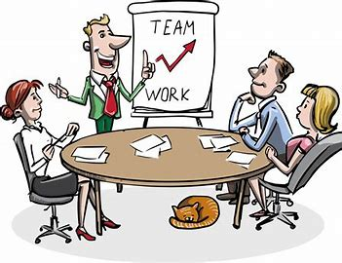
Who should be involved in your pilot?
Identify 3-6 people & families:
  Outcomes that align now
  Supportive
  Similar interests & geography
Identify 1 or 2 DSP champions
Identify who else:
  Executive Director
  Designated coordinator
  Staff supervisor/manager
  Director(s) of Day and Employment
  Admin staff
  Finance/operations
  Nursing
  Transportation
  Communications
  HR/Training
  Who else?
Create a Core Team
Notes:
Staci

Slide 25

How should your pilot be used?
Establish or refine processes
Identify tools needed
Establish new communication flows & frequency:
  What's happening
  What's working/what's not
  What's coming next
  How do we handle speedbumps
Track costs & revenue
Identify bridge funding to scale it up
Build your transformation plan
Partner with the state (and others!)
Build momentum
Notes:
Staci

Slide 26

Your Core Team is Modeling!
Values & culture shift
Language
Communication
Problem solving
Metrics (what)
Data (results)
Story telling
Teamwork (everyone has a voice)
Process
Leadership & management
What happens with thing go 'wrong'
Notes:
Staci

Slide 27

Pilot = Opportunity
Engage program participants in the process
  Foster shared ownership and accountability
    Shared planning
    Shared problem-solving
  Incorporate person-centered approach in "real time"
    Invite and include participant input, feedback, decision making
Notes:
Don

Slide 28

Keep a Sense of Urgency
Use the momentum to keep moving
Keep coming together
Keep problem solving
Admit mistakes
Remain transparent
This Photo by Unknown author is licensed under CC BY.
Notes:
Don

Slide 29

Scale it Up!
What other activities may need to stop?
Budgets
Staffing
Training & development
Processes
What happens if you don't scale up?
Notes:
Don

Slide 30

Are we there yet? Managing Fatigue
Communicate clearly & consistently
Balance stretch goals with being realistic
Prioritize pace and sequencing
Offer support & training
Celebrate successes (small & large)
Promote work-life balance
Lead by example
Notes:
Staci
Session starts at 3pm and runs until 4:45
Break at 4pm: 5 minutes?

Slide 31


What is stopping you??

Slide 32

Stretch Break
Notes:
4pm-4:10pm?
4:10-4:30 small group discussion
4:30-4:45 report out and Q& A?

Slide 33
Making a Plan to Move Forward
Identify at least one organizational goal related to your transformation
What barriers are currently stopping your organization in moving from planning to implementation?
Who is (or should be) part of your pilot core team?
How might you use a pilot?
Identify one (or more) challenge you need to address?
What tools, resources, training, might you need?
Something you heard today that you might take with you?
Notes:
How might we split groups up for small-group discussion?

Slide 34
Resources
&
Support
Minnesota Transformation Initiative https://mti.ici.umn.edu/
  Resources
  Training
  Success stories
  MTI newsletter
  Request assistance!
ThinkWork www.thinkwork.org
  Agency change toolkit
Explore CLE www.cletoolkit.communityinclusion.org
  Toolkit
  Newsletter
  CLE course

Slide 35
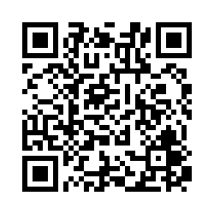
Tell us how we did!
Take this quick survey.

